Slide 1

Chapter 9
Diarrheal, Respiratory, and Other Common Infections

Slide 2
Infectious Diseases and Global Health
9.1

Slide 3
Infectious Disease Burden
Infectious diseases remain responsible for a large proportion of deaths in most low-income countries.
The vast majority of these infections and deaths are preventable with low-cost interventions.
Infectious diseases kill millions of children each year, and reducing child mortality is a global health priority.
  MDG 4: Reduce the mortality rate among children less than 5 years old by two-thirds between 2000 and 2015.
  SDG 3.2: End preventable deaths of young children by 2030.

Slide 4
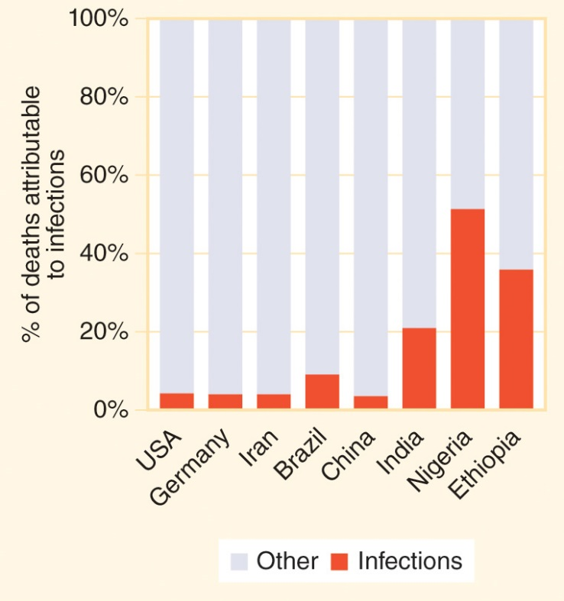
Figure 9-1
Data from GBD Mortality and Causes of Death Collaborators. Global, regional, and national life expectancy, all-cause mortality, and cause-specific mortality for 249 causes of death, 1980–2015: A systematic analysis for the Global Burden of Disease Study 2015. Lancet. 2016; 388:1459-544.
Infectious diseases cause a large proportion of deaths in lower-income countries.

Slide 5
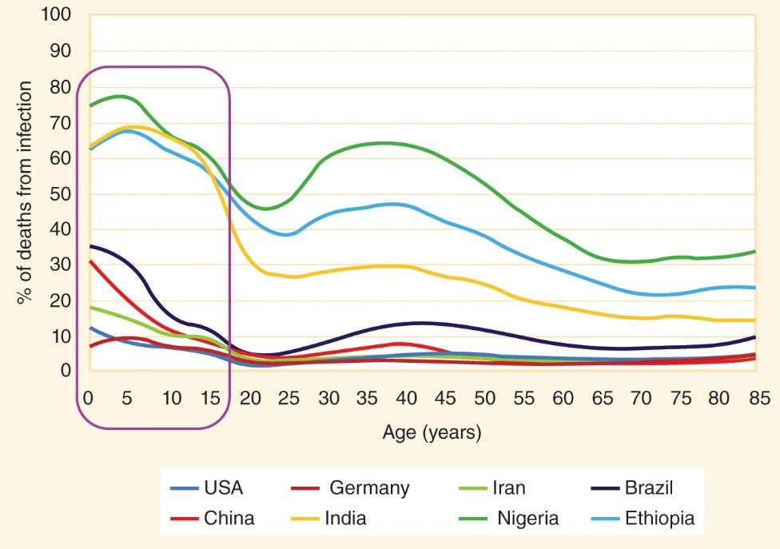
Figure 9-2
Data from GBD Mortality and Causes of Death Collaborators. Global, regional, and national life expectancy, all-cause mortality, and cause-specific mortality for 249 causes of death, 1980–2015: A systematic analysis for the Global Burden of Disease Study 2015. Lancet. 2016; 388:1459-544.
The percentage of deaths that are attributable to infectious diseases peaks in childhood.

Slide 6
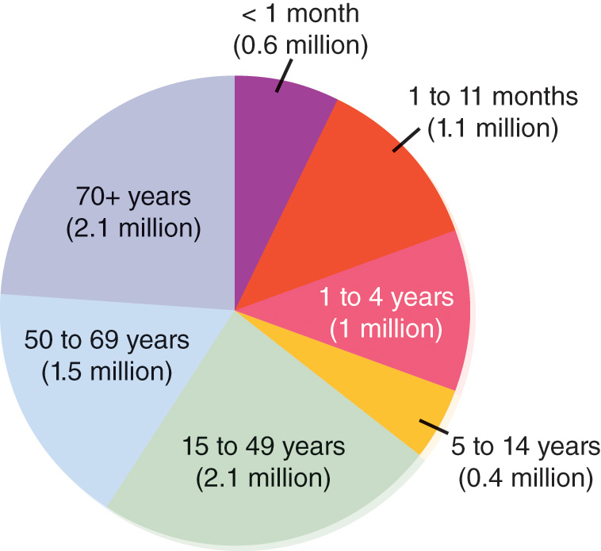
Figure 9-3
Data from GBD Mortality and Causes of Death Collaborators. Global, regional, and national life expectancy, all-cause mortality, and cause-specific mortality for 249 causes of death, 1980–2015: A systematic analysis for the Global Burden of Disease Study 2015. Lancet. 2016; 388:1459-544.
More than 3 million children died from infectious diseases in 2015.

Slide 7
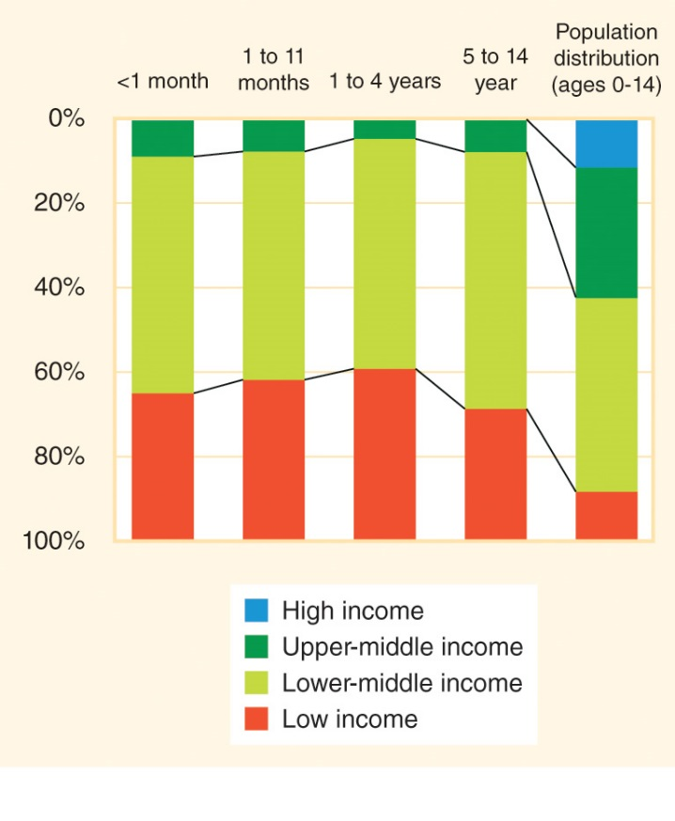
Figure 9-4
Data from GBD Mortality and Causes of Death Collaborators. Global, regional, and national life expectancy, all-cause mortality, and cause-specific mortality for 249 causes of death, 1980–2015: A systematic analysis for the Global Burden of Disease Study 2015. Lancet. 2016; 388:1459-544.
Almost all infectious disease deaths among children (ages 0-14 years) occur in lower-income countries.

Slide 8
Infectious Disease Threat
Infectious diseases can kill or disable people of all ages, all socioeconomic levels, and all geographies.
One country alone cannot stop a pandemic; infectious disease control requires international cooperation.

Slide 9
Diarrheal Diseases
9.2

Slide 10
Diarrheal Diseases
Diarrhea = loose or liquid feces and an increased frequency of defecation.
Dehydration = the excessive loss of water from the body, which can create electrolyte imbalances that cause organ failure and death.
Diarrhea can quickly cause dehydration and death in young children.

Slide 11
Diarrhea in Children
About 1.7 billion cases of diarrhea occur in under-5 children each year.
About 9% of the nearly 6 million children under 5 years old who died in 2015 succumbed to diarrhea (including nearly 16% of deaths in children 1 to 59 months old).
Diarrhea mortality rates are especially high among children who are undernourished.

Slide 12
Diarrheal Disease Agents
The most common diarrhea-causing pathogens include:
  Viruses: rotaviruses, noroviruses, astroviruses, and adenoviruses
  Bacteria: Vibrio cholerae, Escherichia coli, Salmonella species (including the ones that cause typhoid and paratyphoid), Shigella, Campylobacter jejuni, and Aeromonas
  Protozoa: Entamoeba histolytica, Giardia, and Cryptosporidium
Enteric infections = infections of the intestinal tract.

Slide 13
Viral Diseases
Rotavirus = the most common cause of severe diarrhea in infants and young children.
Norovirus = the most common cause of severe diarrhea in adults.

Slide 14
Bacterial Diseases
Cholera = an infection with Vibrio cholerae bacteria that causes large volumes of severe watery diarrhea to be secreted into the small intestine.
E. coli bacteria are very common; some strains are pathogenic and release toxins into the body.
  Food intoxication = illness caused when ingested bacteria produce toxins in the body.

Slide 15
Bacterial Diseases (cont’d)
Campylobacteriosis = a disease of the small intestine usually acquired through undercooked poultry and meat products.
Typhoid (Salmonella typhi) causes severe diarrhea and a high fever, and it can persist for a month and cause intestinal perforation.
  Carrier = a person with a persistent contagious infection who does not have symptoms of the disease but can pass the infectious agent on to others through their stool.
Dysentery = bloody diarrhea, with the blood often mixed with mucus.

Slide 16
Parasitic Diseases
Cryptosporidiosis = a waterborne protozoal disease that causes outbreaks in humans when drinking water supplies become contaminated.
Giardiasis = a protozoan infection that can cause persistent diarrhea for several months or longer.

Slide 17
Foodborne Diseases That Are Not Diarrheal
Brucellosis = caused by bacteria transmitted to humans through unpasteurized dairy products and contact with livestock; if untreated, the infection may cause chronic cyclic fevers.
Helicobacter pylori = a bacterium associated with stomach ulcers.
Listeriosis = a foodborne bacterial infection that can cause miscarriages, stillbirths, and preterm delivery when pregnant women contract it.
Botulism = a rare disease that can cause paralysis and death when the toxin is ingested from improperly canned goods.

Slide 18
Diarrhea Interventions
9.3

Slide 19
Fecal-Oral Transmission
Fecal-oral transmission = infectious agents spread when a person ingests products contaminated with fecal material from animals or humans.
“5 Fs”: fluids, fields, fingers, flies, and food.
Fomite = an inanimate object or surface that has been contaminated with infectious agents.
Diarrhea prevention methods therefore include safe drinking water (fluids), access to toilets (fields), hand hygiene (fingers), insect control (flies), food safety (food), and surface disinfection (fomites).

Slide 20
Child Diarrhea Prevention
Safe drinking water
Community-wide sanitation
Frequent handwashing with soap
Breastfeeding and nutrition promotion
Vitamin A and zinc supplementation
Vaccinations against rotavirus, measles, and (where available) cholera

Slide 21
Diarrhea Treatment
Oral rehydration therapy (ORT) = drinking enough water to prevent or treat the dehydration caused by diarrhea.
Oral rehydration salts/solution (ORS) = a mixture of sugar, salt, and clean drinking water that replaces lost fluids and restores the balance of electrolytes in the blood.
Continued feeding = the process of encouraging children with diarrhea to eat the same foods that they normally consume and continuing to breastfeed infants and young children as usual during their illness.

Slide 22
Diarrhea Mortality Interventions
Educating parents and communities about ORS and continued feeding
Providing zinc treatment, probiotics, and antibiotics for diarrhea (when appropriate)
Encouraging recovering children to eat more food than normal to regain lost weight and lost nutrients

Slide 23
Global Action Plan
The mortality rate from diarrhea among children less than 5 years old decreased by more than 60% between 2000 and 2015, from 9.5 per 1000 live births to 3.8 per 1000 live births.
The number of deaths of children less than 5 years old from diarrhea decreased from about 1.2 million in 2000 to 525,000 in 2015.
The Global Action Plan for Pneumonia and Diarrhea (GAPPD) aims to reduce the under-5 diarrhea mortality rate to less than 1 per 1000 live births by 2025.

Slide 24
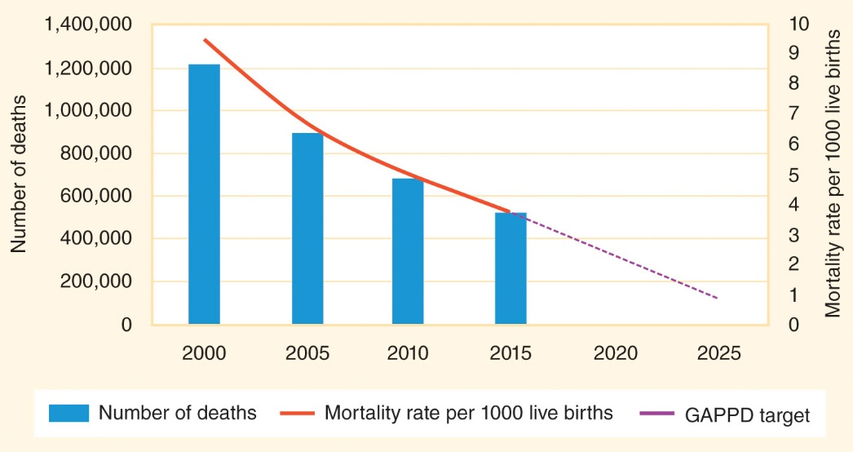
Figure 9-5
Data from Liu L, Oza S, Hogan D, Chu Y, Perin J, Zhu J, Lawn JE, Cousens S, Mathers C, Black RE. Global, regional, and national causes of under-5 mortality in 2000–15: An updated systematic analysis with implications for the Sustainable Development Goals. Lancet 2016; 388:3027-35.
The diarrhea mortality rate in children ages 0 to 59 months has decreased significantly since 2000.

Slide 25
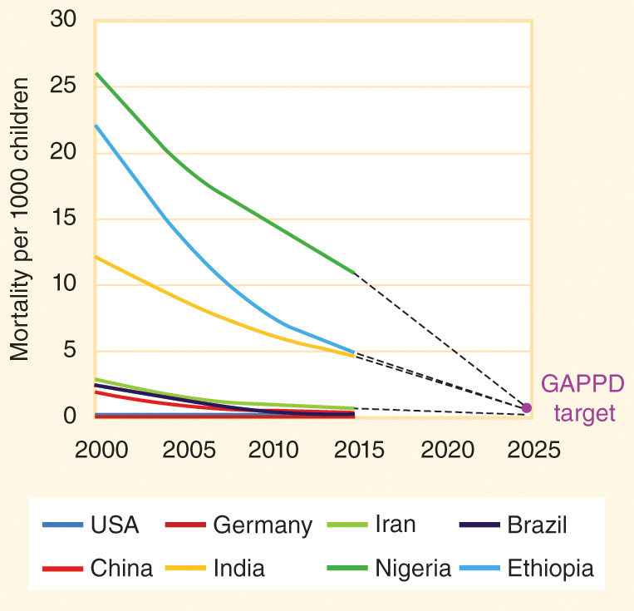
Figure 9-6
Data from Department of Evidence, Information and Research (WHO) and Maternal Child Epidemiology Estimation (MCEE) Group. WHO-MCEE estimates for child causes of death 2000–2015. Geneva: WHO; 2016.
The diarrhea mortality rate per 1000 live births in children ages 0 to 59 months has decreased significantly in lower-income countries.

Slide 26
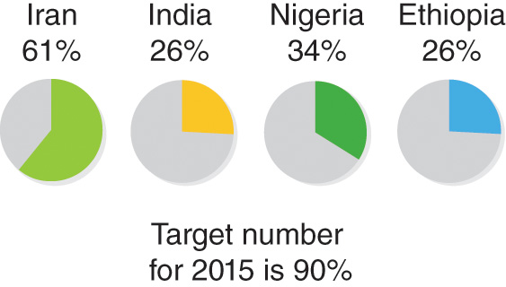
Figure 9-7
Data from State of the world’s children 2016. New York: UNICEF; 2016.
Percentage of children less than 5 years old with diarrhea who receive oral rehydration salts (ORS).

Slide 27
Food Safety
Keeping the kitchen clean
Washing hands often
Separating raw and cooked food
Cooking food thoroughly
Keeping food at safe hot or cold temperatures
Using safe food products

Slide 28
Pneumonia
9.4

Slide 29
Pneumonia
The main function of the body’s respiratory system is the exchange of gases, which mostly means taking in oxygen and getting rid of carbon dioxide.
Pneumonia occurs when part of a lung fills with fluid.
  When the alveoli are filled with fluid, they cannot efficiently exchange oxygen and carbon dioxide
  The symptoms of a pneumonia usually include a cough accompanied by difficult rapid breathing.
  Hypoxia = an inadequate supply of oxygen in body tissues.

Slide 30
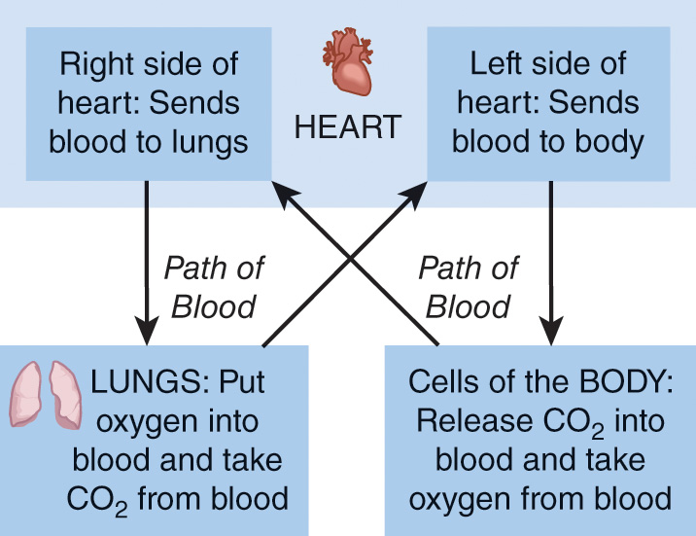
Figure 9-8
Path of blood through the heart, lungs, and body.

Slide 31
Pneumonia Epidemiology
The mortality rate from pneumonia among children less than 5 years old decreased by more than 50% between 2000 and 2015, from 13.6 per 1000 live births to 6.6 per 1000 live births.
The number of deaths from pneumonia of children less than 5 years old decreased from about 1.74 million in 2000 to 920,000 in 2015.
Pneumonia remains the most common cause of infectious disease death in children less than 5 years old.
In 2015, about 15.5% of the nearly 6 million children less than 5 years old who died succumbed to pneumonia (including 23% of the deaths in children 1 to 59 months old).
The Global Action Plan for Pneumonia and Diarrhea (GAPPD) aims to reduce the under-5 pneumonia mortality rate to less than 3 per 1000 live births by 2025.

Slide 32
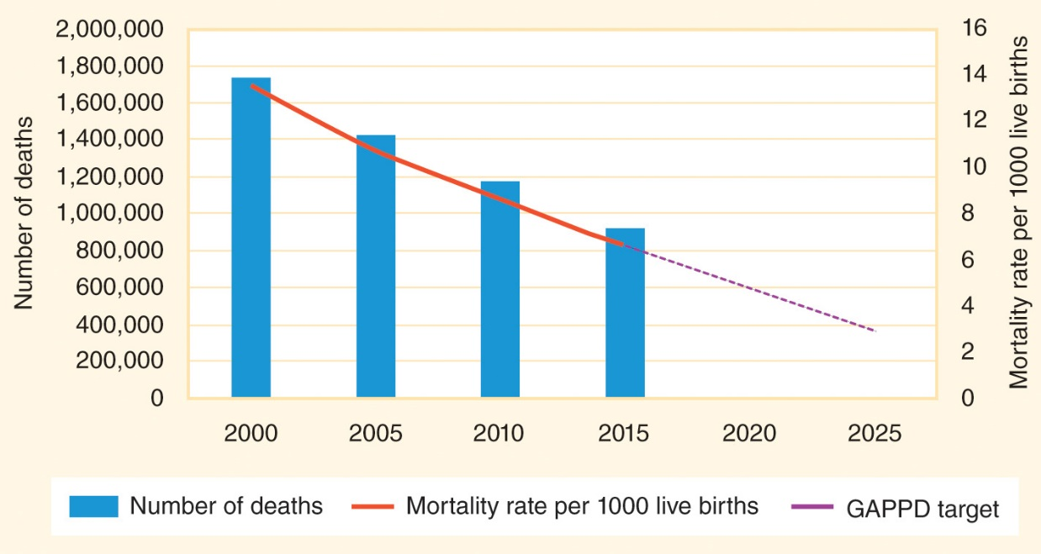
Figure 9-9
Data from Liu L, Oza S, Hogan D, Chu Y, Perin J, Zhu J, Lawn JE, Cousens S, Mathers C, Black RE. Global, regional, and national causes of under-5 mortality in 2000–15: An updated systematic analysis with implications for the Sustainable Development Goals. Lancet 2016; 388:3027-35.
The pneumonia mortality rate in children ages 0 to 59 months has decreased significantly since 2000.

Slide 33
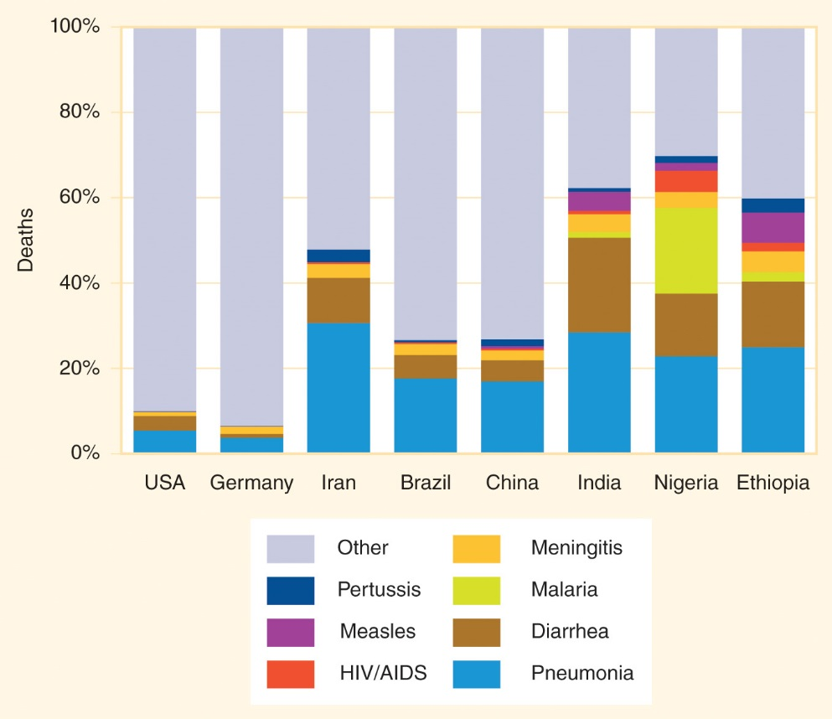
Figure 9-10
Data from Liu L, Oza S, Hogan D, Chu Y, Perin J, Zhu J, Lawn JE, Cousens S, Mathers C, Black RE. Global, regional, and national causes of under-5 mortality in 2000–15: An updated systematic analysis with implications for the Sustainable Development Goals. Lancet 2016; 388:3027-35.
Percentage of deaths in children ages 1 to 59 months (post-neonatal under-5 mortality) caused by seven common infectious diseases in 2015.

Slide 34
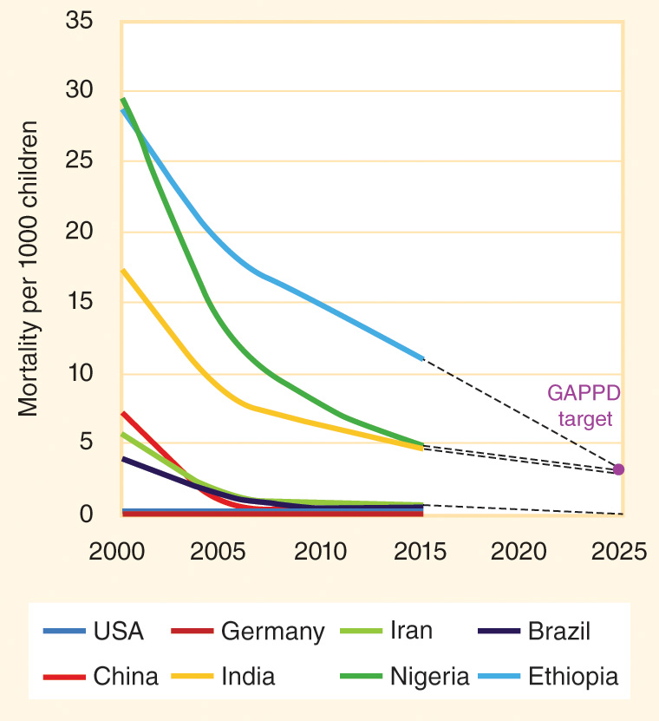
Figure 9-11
Data from Department of Evidence, Information and Research (WHO) and Maternal Child Epidemiology Estimation (MCEE) Group. WHO-MCEE estimates for child causes of death 2000–2015. Geneva: WHO; 2016.
The pneumonia mortality rate per 1000 live births in children ages 0 to 59 months has decreased significantly in lower-income countries.

Slide 35
Common Causes of Pneumonia
Pneumococcus = the severe pneumonia caused by infection with Streptococcus pneumoniae
Hib = a vaccine-preventable bacterial infection with Haemophilus influenzae type b (Hib) that causes influenza-like illness
Respiratory syncytial virus (RSV) = a common cause of severe pneumonia in preterm infants and other vulnerable babies
Influenza
Many other agents

Slide 36
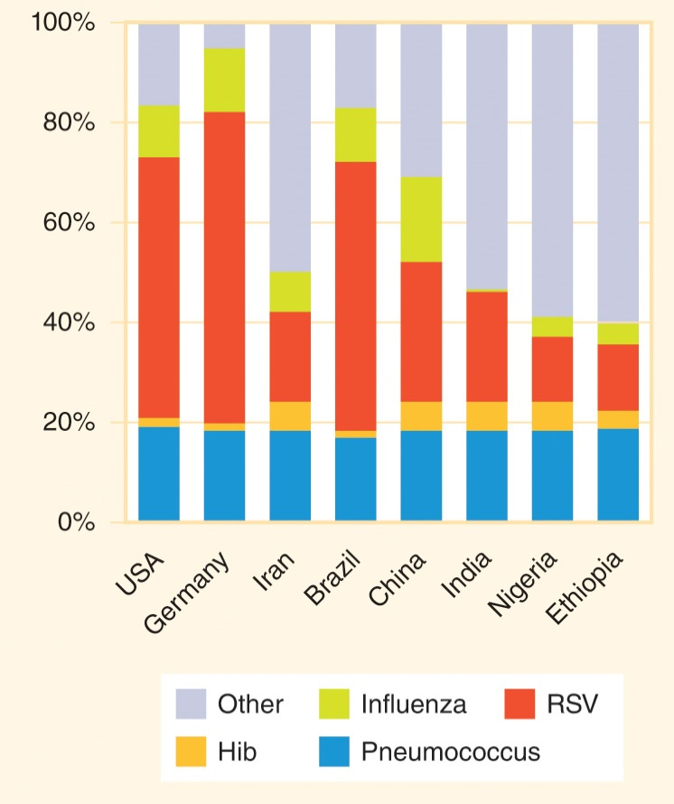
Figure 9-12
Data from Rudan I, O’Brien KL, Nair H, Liu L, Theodoratou E, Qazi S, Lukšić I, Fischer Walker CL, Black RE, Campbell H; Child Health Epidemiology Reference Group. Epidemiology and etiology of childhood pneumonia in 2010: Estimates of incidence, severe morbidity, mortality, underlying risk factors and causative pathogens for 192 countries. J Glob Health 2013; 3:010401.
Common causes of severe pneumonia in children ages 0 to 59 months in 2010.

Slide 37
Pneumonia Treatment
Bacterial pneumonia can often be cured by inexpensive oral antibiotics if treatment is sought soon after the onset of symptoms.
Only about 63% of the world’s under-5 children with suspected pneumonia are taken to a healthcare provider and an even lower percentage are treated with antibiotics.
More than 10 million children are hospitalized each year because of severe pneumonia.
More than 80% of child pneumonia deaths occur outside of hospitals.
Educating caregivers about the importance of seeking medical care as soon as the symptoms of pneumonia appear is an important component of mortality prevention interventions.

Slide 38
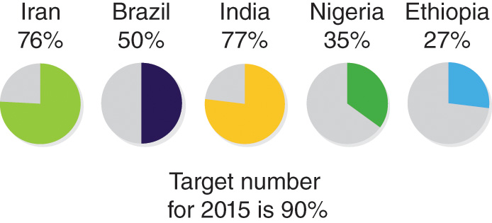
Figure 9-13
Data from State of the world’s children 2016. New York: UNICEF; 2016.
Percentage of children less than 5 years old with symptoms of pneumonia who receive care from a health facility or provider.

Slide 39
Other Respiratory Infections
9.5

Slide 40
Other Respiratory Diseases
Acute respiratory infection (ARI) = a short-term infection of the respiratory tract that typically has a rapid onset and resolves without becoming a chronic infection.
  If untreated, strep throat can lead to complications such as scarlet fever or rheumatic fever, which causes permanent damage to the valves of the heart.
Lower respiratory infections (LRIs) = acute respiratory infections of the bronchi and lungs, including infectious bronchitis and pneumonia.

Slide 41
Transmission
Most respiratory infections are acquired through airborne transmission, which occurs when pathogens are aerosolized or suspended as droplets in the air and people breathe in that contaminated air.
Respiratory pathogens can also be transmitted through contact with hands or surfaces that have been contaminated by droplets expelled from the airways of infected persons when sneezing or coughing.

Slide 42
Transmission (cont’d)
Legionnaires’ disease is acquired through the inhalation of moistened water from air conditioners, hot tubs, and humidifiers.
Hantaviruses can be acquired by inhaling aerosolized rat urine or feces when cleaning.
Psittacosis (parrot fever) is acquired when bird owners inhale the dried bird droppings of infected pets.
Coccidioidomycosis (valley fever) is caused by a fungus that lives in desert soil.
Histoplasmosis is caused by a fungus in soil containing bird or bat droppings.

Slide 43
Prevention
Isolating infected persons and providing them with appropriate medical treatment
Vaccinating members of vulnerable population groups against Hib, pneumococcus, and pertussis
Reducing exposure to indoor air pollution and smoke
Reducing household overcrowding
Using protective equipment at workplaces where occupational exposure to respiratory pathogens is likely
Encouraging frequent handwashing and the covering of the nose and mouth when coughing or sneezing

Slide 44
Influenza
9.6

Slide 45
Influenza
Influenza is a highly contagious respiratory viral infection that can lead to a potentially fatal secondary infection with bacterial pneumonia.
  “Stomach flu” is not caused by influenza viruses.
Seasonal influenza outbreaks occur every year, but there is always a risk of the emergence of a novel strain of influenza sparking a dangerous pandemic influenza.
The most serious influenza pandemic in the 20th century occurred in 1918–1919 during World War I.

Slide 46
Antigenic Change
Antigen = a foreign substance in the body that triggers an immune response.
The two key surface antigens for influenza A are hemagglutinin (H) and neuraminidase (N).
There are two processes by which surface antigens change, antigenic drift and antigenic shift.
Antigenic drift occurs when small genetic mutations bring about small changes in the antigens.
  Antigenic drift makes it necessary to develop a new influenza vaccine every year.
Antigenic shift occurs when two very different influenza types of influenza A viruses combine to form a new type of influenza.

Slide 47
Vocabulary
Transmissibility = the ease with which an infectious agent is passed from an infected host to another individual.
Infectivity = the capacity of an infectious agent to cause infection in a susceptible host.
  Secondary attack rate = the average number of other people that one contagious person infects.
Pathogenicity = the capacity of an infectious agent to cause disease in an infected host.
Virulence = the ability of an infectious agent to cause severe disease or death in a host, and it is measured by the proportion of severe or fatal cases among all people who become ill.
  Case fatality rate (CFR) = the percentage of people who become ill from the infection will die from that infection.

Slide 48
Emergence
Influenza viruses affect humans and also many types of animals, including chickens, ducks, pigs, horses, and even dogs, whales, and bats.
Most strains of influenza that affect humans originate in bird or mammal populations.
  Anthroponosis = an infectious disease that usually occurs only in humans.
  Zoonosis = an infectious disease that usually occurs in animals and only occasionally infects humans.
The World Health Organization (WHO)’s Pandemic Alert System keeps member nations and the public informed about the spread of the new influenza strains.

Slide 49
Diagnosis and Treatment
Rapid laboratory tests are available to confirm the presence of influenza A or B viral antigens in body fluids.
  People with suspected influenza who have not tested positive for the virus are said to have an influenza-like illness (ILI).
Antiviral drugs can reduce the severity of symptoms from some strains of influenza, but they do not cure the infection.

Slide 50
Public Health Interventions
Isolation = the separation of people who have tested positive for a contagious infection from healthy people who are susceptible to the infection.
  Personal protective equipment (PPE) = gowns, gloves, facemasks, eye protection, and other barriers that prevent infection.
Quarantine = the restriction of freedom of movement for contacts of infected people because they may become contagious, even though at the time of quarantine they have no symptoms of infection.
  Isolation is for sick people; quarantine is for healthy contacts of sick people.
  Contact tracing = the process of identifying the primary contacts of infected individuals as well as, perhaps, the contacts of those primary contacts (secondary contacts), so that they can be tested and monitored.
Vaccination is also an important tool when there is an available vaccine for the circulating strain.

Slide 51
Immunization
9.7

Slide 52
Vaccination
Vaccination = the intentional delivery of a substance into the body in order to stimulate development of immunity against a particular disease.
Immunization = the process of a person’s immune system developing immunity against a particular infection.
  Vaccination is the action of delivering a vaccine to an individual; immunization is what happens in the body after a vaccine is injected or otherwise dispensed.
Antibody = a protein produced by the human body in response to the presence of antigens; antibodies can bind to antigens and destroy them.

Slide 53
Immunity
Active immunity is present when the body’s immune system produces antibodies against a specific infectious agent.
  Conferred by both infection and vaccination
  Confers long-lasting protection against an infectious disease
Passive immunity is temporary protection from antibodies produced by another human or an animal.
  Newborns and infants have some protection from maternal antibodies.
  Blood products and immunoglobulin shots also provide passive immunity.

Slide 54
Types of Vaccines
A live attenuated vaccine contains a pathogen that has been weakened with various laboratory techniques.
An inactivated vaccine contains a killed bacterium or an inactive virus that has been rendered harmless by heat, chemical, or radiation.
An adjuvant is an ingredient added to some types of vaccines to boost the body’s immune response to the vaccine.
A fractional vaccine contains parts of a pathogen rather than the entire microbe.

Slide 55
Vaccine Safety
Licensed vaccines have undergone extensive testing to prove they are safe for most people.
Adverse reaction = a side effect of vaccination (most often redness at the injection site or local pain).
Adverse event = adverse reaction or other medical event that occurs after vaccination but appears to be coincidental rather than being a result of the vaccine.

Slide 56
Vaccine Safety (cont’d)
Contraindication = a condition that makes it unsafe for an individual to receive a particular vaccine.
Precaution = a condition that might make a vaccine ineffective at producing immunity or might increase the likelihood of an adverse reaction in a particular individual.

Slide 57
Herd Immunity
The theory of herd immunity says that reducing the proportion of a population that is susceptible to an infection protects the whole population, including those who are unable to receive vaccines.

Slide 58
Vaccine-Preventable Infections
9.8

Slide 59
Routine Vaccinations
The first global vaccination initiative was the Expanded Program on Immunization (EPI), which was established by the World Health Organization in 1974 to ensure universal child access to vaccines for six vaccine-preventable diseases (VPDs): measles, polio, tuberculosis (BCG), diphtheria, tetanus, and pertussis.
About a dozen vaccines are now routinely recommended for children, including mumps, rubella, hepatitis B, influenza, Hib, pneumococcus, and rotavirus.

Slide 60
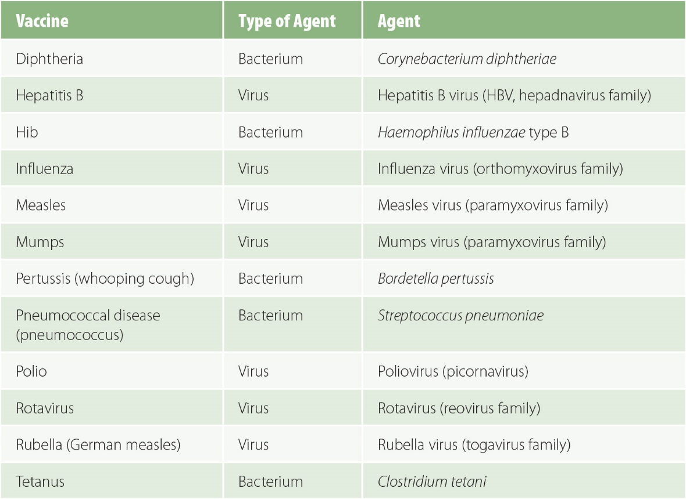
Figure 9-14
Routinely recommended childhood vaccinations.

Slide 61
Measles, Mumps, Rubella (MMR)
Measles = a very contagious viral infection that can cause serious complications, especially in children who are vitamin A deficient.
  The number of measles deaths worldwide per year decreased from an estimated 650,000 in 2000 to 135,000 in 2015, an 80% decrease in just 15 years.
  The percentage of infants receiving at least one dose of a measles-containing vaccine (MCV) increased from 72% to 85% during those 15 years.
Mumps causes swollen cheeks and may lead to male infertility.
Rubella can cause congenital defects if pregnant women contract it.

Slide 62
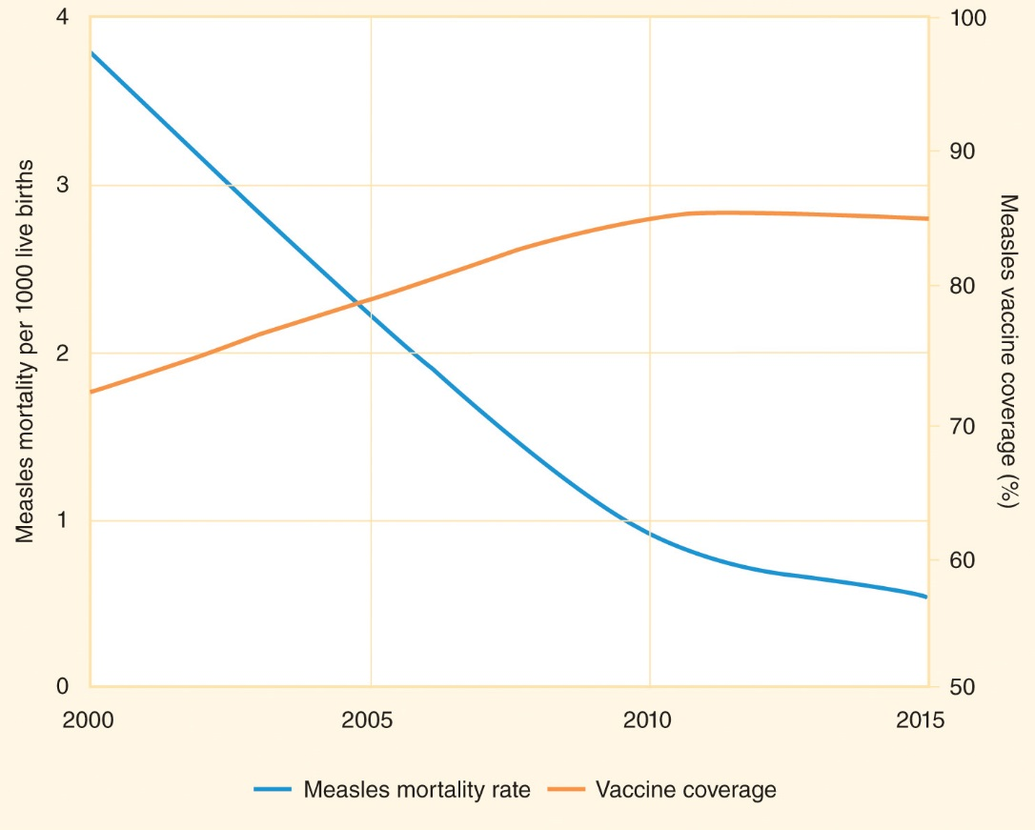
Figure 9-15
Data from Department of Evidence, Information and Research (WHO) and Maternal Child Epidemiology Estimation (MCEE) group. WHO-MCEE estimates for child causes of death 2000–2015. Geneva: WHO; 2016.
The measles mortality rate per 1000 live births in children ages 0 to 59 months decreased as the infant vaccine coverage increased.

Slide 63
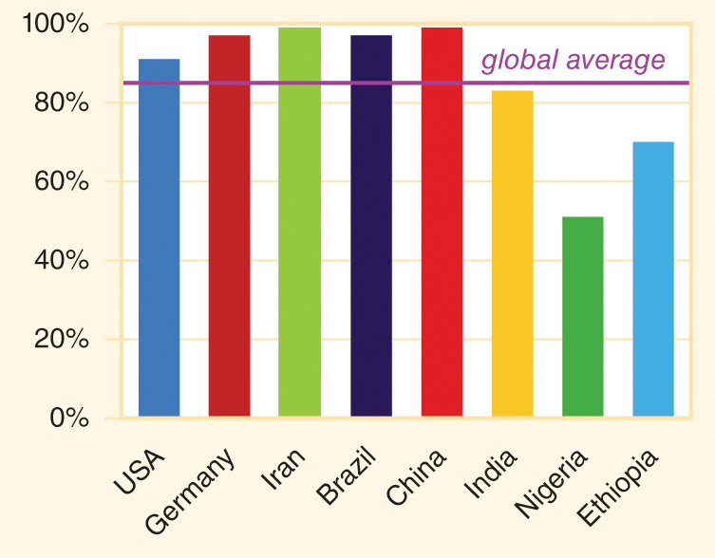
Figure 9-16
Data from State of the world’s children 2016. New York: UNICEF; 2016.
Percentage of infants receiving at least one dose of a measles-containing vaccine (MCV) in 2015.

Slide 64
Diphtheria, Tetanus, Pertussis (DTP)
Diphtheria causes inflammation of the airway that can become a fatal airway obstruction.
Tetanus causes painful muscle spasms throughout the body.
Pertussis, also known as whooping cough, causes violent fits of coughing and can be fatal in infants.

Slide 65
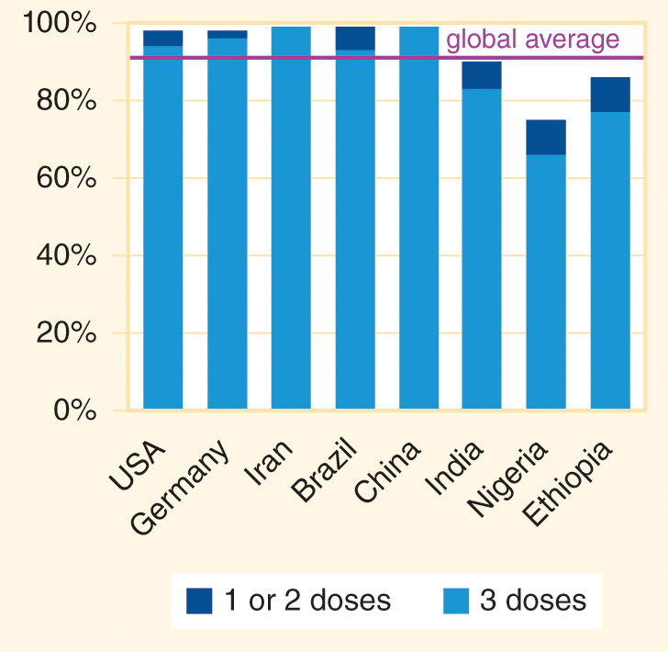
Figure 9-17
Data from State of the world’s children 2016. New York: UNICEF; 2016.
Percentage of infants receiving a diphtheria, tetanus, and pertussis (DTP) vaccine in 2015.

Slide 66
Other Vaccines
Influenza, Hib, and pneumococcus vaccines protect against respiratory infections.
Rotavirus vaccines protect against a type of severe gastroenteritis.
  Many countries cannot afford to include these vaccines in their childhood vaccination schedules.
Polio is a viral infection that causes paralysis in a small percentage of the people who contract it.
  A polio eradication campaign began decades ago.
Other available vaccines are recommended in some world regions and for some populations with high risk.

Slide 67
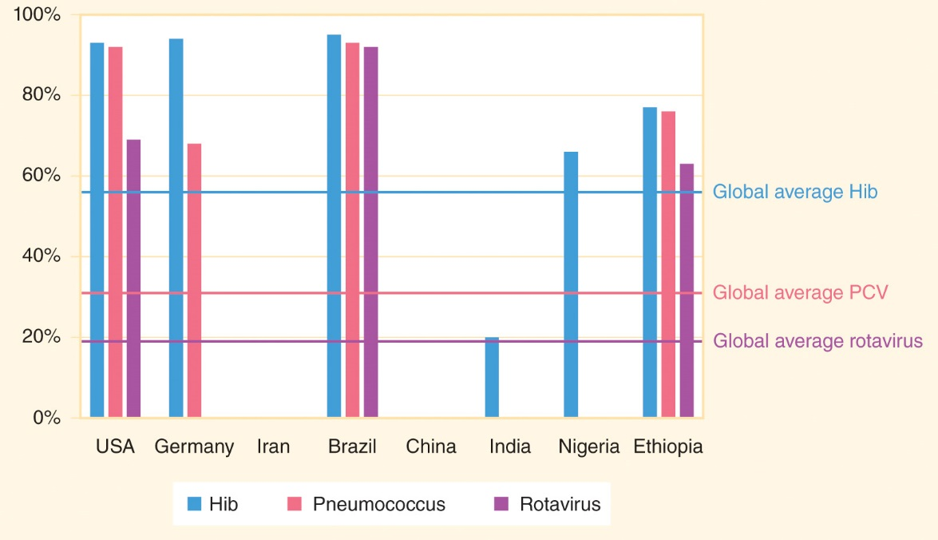
Figure 9-18
Data from State of the world’s children 2016. New York: UNICEF; 2016.
Percentage of infants receiving three doses of Hib (Haemophilus influenzae type B) vaccine, rotavirus vaccine, and three doses of pneumococcal conjugate vaccine (PCV) in 2015.

Slide 68
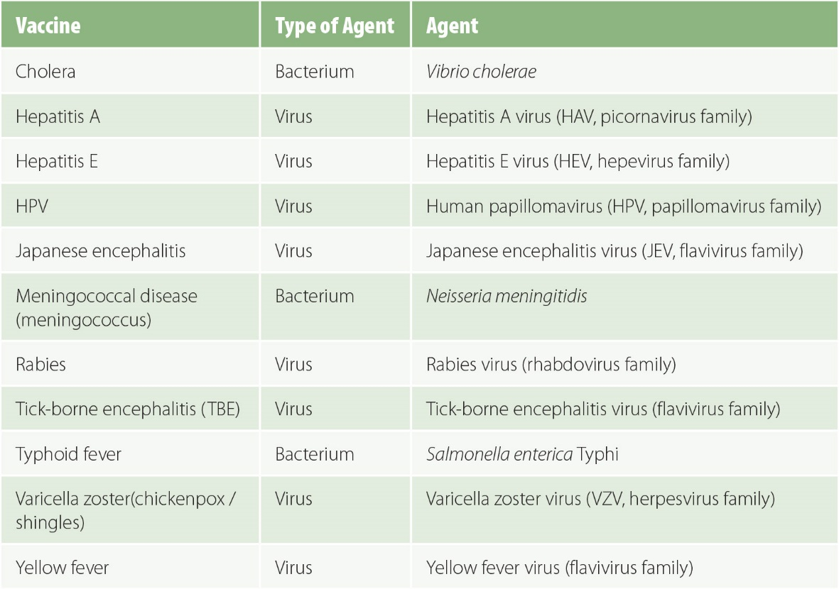
Figure 9-19
Examples of other available vaccinations.

Slide 69
Vaccine Access
Significant progress is being made in increasing access to vaccinations in low- and middle-income countries through partnerships like Gavi, the Vaccine Alliance.
Further increases in vaccination coverage will require concurrent strengthening of health systems, disease surveillance coverage, laboratory testing capacity, health communications networks, and safety monitoring systems.

Slide 70
Viral Hepatitis
9.9

Slide 71
Viral Hepatitis
Several types of viral hepatitis caused by very different types of viruses can trigger inflammation of the liver.
About 1 million people each year die from acute or chronic viral hepatitis or the aftereffects of chronic infection, including HBV- and HCV-associated liver cancers.

Slide 72
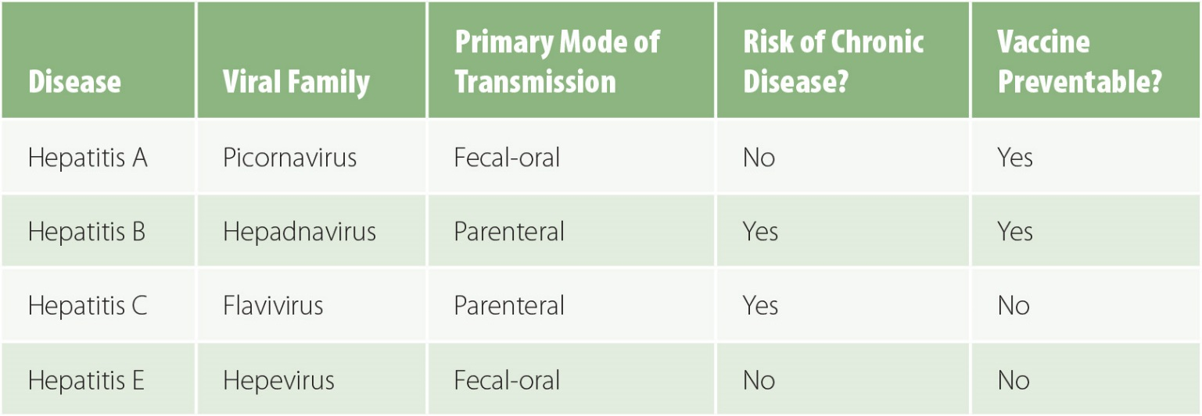
Figure 9-20
Major types of viral hepatitis

Slide 73
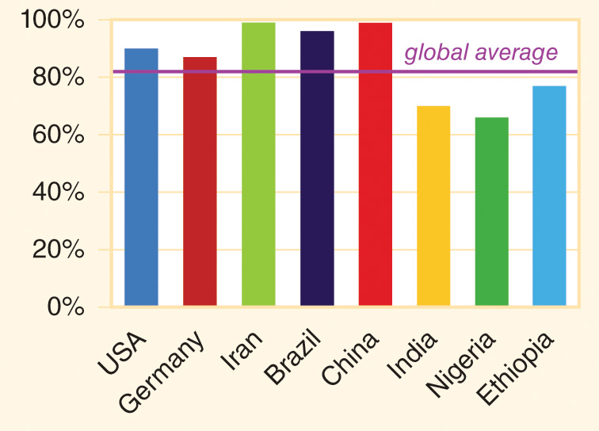
Figure 9-21
Data from State of the world’s children 2016. New York: UNICEF; 2016.
Percentage of infants receiving three doses of hepatitis B vaccine in 2015.

Slide 74
Meningitis
9.10

Slide 75
Meningitis
Meningitis = inflammation of the meninges, the membranes the cover the brain and spinal cord.
  Viral infections are the most common cause of meningitis, but bacterial meningitis is of greater concern because it has a higher case fatality rate.
  Three of the frequent causes are vaccine-preventable: pneumococcus, meningococcus, and Hib.
Meningococcus = the disease caused by infection with the bacterium Neisseria meningitidis.
  The “meningitis belt” extends across the northern countries of sub-Saharan Africa where large outbreaks of meningococcus have historically occurred every few years during the dry season.

